Slide 1
Community Health Portal project
Samin Karim
Samin.karim@gmail.com
Skype: samink

Slide 2




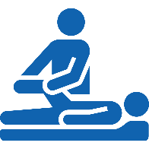

The Target Product
Many patients with chronic diseases, or who are elderly and infirm, need to have care from multiple carers (providers) - all managed by a care coordinator
A tablet application (for iPad / Android tablet) would help the care coordinator to manage their patients as well as the team of carers looking after them
Patient
The App
Care Coordinator
Care team
In Scope

Slide 3
The Target Product
The tablet application would have multiple functions and data:
Patient file can be created with their personal details (address, phone number)
A “care plan” can be created for the patient / client
Web server stores the data
Application connects to web server, but can store data (encrypted) and work without internet connection - syncing data when internet connection is available
All data to be encrypted, and also use HTTPS for connection from tablet application access (for security)
In Scope

Slide 4
Provider Login Screen
Standard login function
Forgot password and username functionality
Forgot username can send SMS to mobile number to send username (email address)
Forgot password uses email address (username) to send new reset password
In Scope

Slide 5
Client / Patient Registration
First search for a patient (to check if he/she exists in system)
If not exists, user taps “New Client” and fills in form for new patient
This process is performed for client search as well
Email address field must do data validation (make sure it is in email address format with “@” and domain name format – use standard data validation libraries)
In Scope

Slide 6
Client Details View
Provider can view patient, once selected from client search
If “New Client” is clicked, run the “Client / Patient Registration” process above
Screen below is the compact view when user swipes to left, or taps the icon
In Scope

Slide 7
Client Care Plan
Each patient has 1 care plan each
Start by entering care plan reason
In Scope

Slide 8
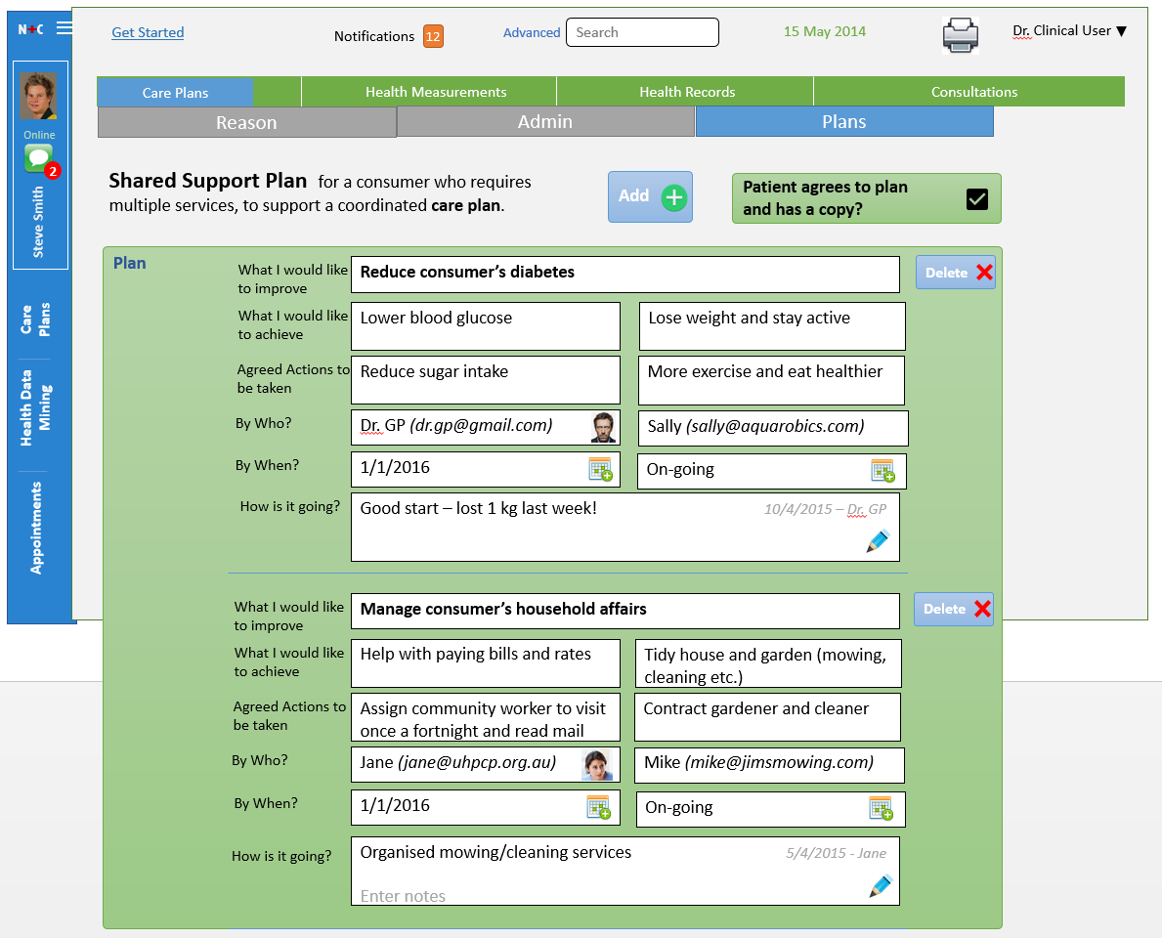
Client Care Plan
This is most important screen: define care plan
Each plan has 2 of
Goal (“What I would like to achieve)
Agreed actions
Care team member (“By Who?”, e.g. Dr. GP)
Date (“By When?”)
Progress (“How is it going?”)
User can scroll down to see all plan steps
Reminders
Sent to the care team member once a week to enter progress notes until 1 week before Date entered in “By When?”
For now, don’t worry about care team member login, just send reminder to care team member
In Scope

Slide 9
App Map – Only some of the screens will be developed in Release 1
In Scope

Slide 10
Database Schemas
Need to have a neat, normal form database design
MongoDB preferred for better analytics and flexibility – happy to consider other DBs
Will supply detailed DB designs
In Scope

Slide 11
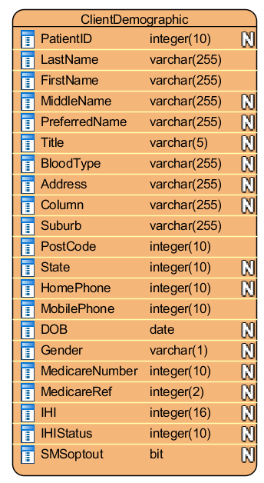
Database Schemas Client (Patient)
Single table is sufficient for client details
In Scope

Slide 12
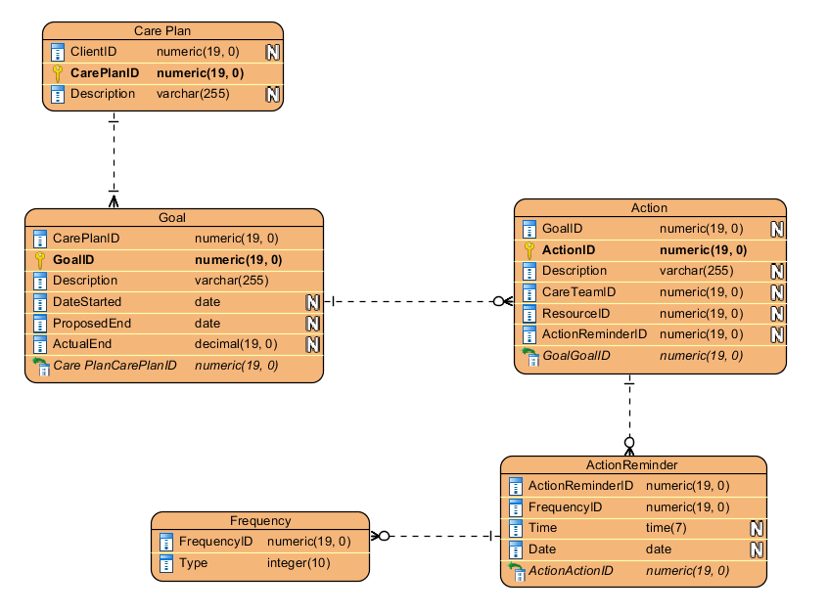
Database Schemas Care Plan
Care Plan
ClientID is the client the care plan relates to.
Action
CareTeamID is the provider (ProviderID) responsible for the action. This can be either a provider in the system, or another provider not registered in the system
If the CareTeamID is not a provider, then it is stored as a basic provider not associated with any organisation
In Scope

